Slide 1
Digital Systems 18B11EC213
Signal and Its Classifications

Slide 2
Contents
Signal Definition
CT and DT Signals
Even and Odd
Periodicity
Energy and Power
Basic CT and DT signals
Signal Transformation

Slide 3
Signal
A signal is a function of one or more independent variables and typically it contains information about the behavior or nature of the phenomenon.
Mathematically, a signal is represented as a function of an independent variable t. Usually t represents time. Thus, a signal is denoted by x(t).

Slide 4
Continuous-Time and Discrete-Time Signals
A signal x(t) is a continuous-time signal if t is a continuous variable.
If t is a discrete variable-that is, x(t) is defined at discrete times-then x(t) is a discrete-time signal.
Since a discrete-time signal is defined at discrete times, a discrete-time signal is often identified as a sequence of numbers, denoted by {xn} or x[n], where n = integer. Illustrations of a continuous-time signal x(t) and of a discrete-time signal x[n] are shown in Fig. 1.

Slide 5
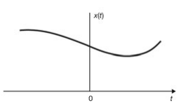
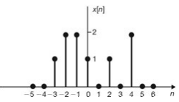
(a)
(b)
Fig. 1 Graphical representation of (a) continuous-time and (b) discrete-time signals

Slide 6
Even and Odd Signals
A signal x(t) or x[n] is called to be an even signal if
x(-t) = x(t)
x[-n] = x[n]
The even signals have symmetry about vertical axis.
A signal x(t) or x[n] is said to be an odd signal if
x(-t) = -x(t)
x[-n] = -x[n]
The odd signals have anti-symmetry about vertical axis.

Slide 7
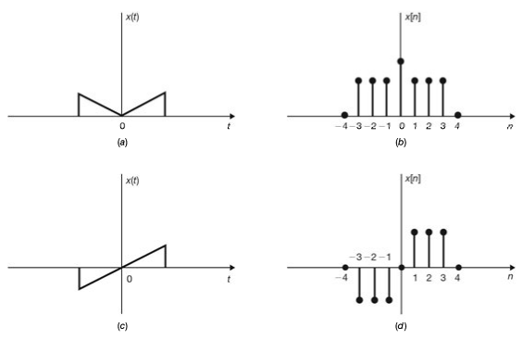
Examples of even and odd signals
Fig. 2. Examples of even signals (a and b) and odd signals (c and d).

Slide 8
Even and Odd Parts
Any signal x(t) or x[n] can be expressed as a sum of two signals, one of which is even and one of which is odd. That is,
x(t) = x_{e}(t) + x₀(t)
x[n] = x_{e}[n] + x₀[n]

Slide 9
Even and Odd Parts
Ex. Find the even and odd components of x(t) = e^{jt}
Sol: x(t) = e^{jt} = x_{e}(t) + x₀(t)

Slide 10
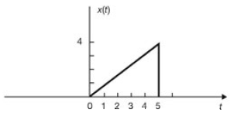
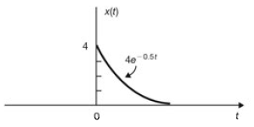
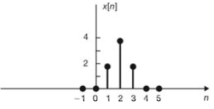
Even and Odd Parts
Ex. Sketch and label the even and odd components of the following signals:
(a) (b)
(c)

Slide 11
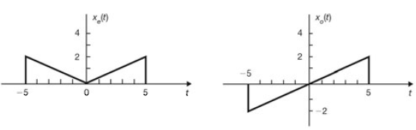
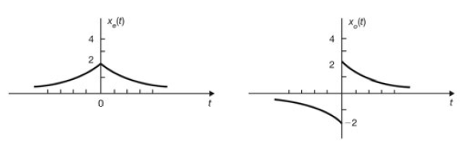
Even and Odd Parts
Sol. (a)
Sol. (b)

Slide 12
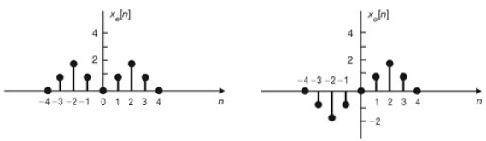
Even and Odd Parts
Sol. (c)

Slide 13
Periodic and Non-periodic Signals
A continuous-time signal x(t) is said to be periodic with period T if there is a positive nonzero value of T for which
x(t + T) = x(t) for all t
The fundamental period T₀ of x(t) is the smallest positive value of T for which above Eq. holds.
Note that this definition does not work for a constant signal x(t) (known as a dc signal). For a constant signal x(t) the fundamental period is undefined since x(t) is periodic for any choice of T (and so there is no smallest positive value).
Any continuous-time signal which is not periodic is called a non-periodic (or aperiodic) signal.

Slide 14
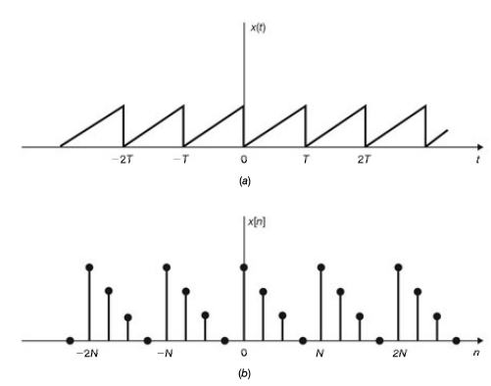
Examples of Periodic Signals
Fig. 3. Examples of periodic signals (a) continuous time periodic signal (b) discrete time periodic signal

Slide 15
Periodic discrete-time signals
A sequence (discrete-time signal) x[n] is periodic with period N if there is a positive integer N for which
x[n + N] = x[n] for all n
The fundamental period N₀ of x[n] is the smallest positive integer N for which above Eq. holds.
Any sequence which is not periodic is called a non-periodic (or aperiodic) sequence.
Note that a sequence obtained by uniform sampling of a periodic continuous-time signal may not be periodic.
Note also that the sum of two continuous-time periodic signals may not be periodic but that the sum of two periodic discrete sequences is always periodic.

Slide 16
Periodicity
Ex. Let x₁(t) and x₂(t) be periodic signals with fundamental periods T₁ and T₂, respectively. Under what conditions is the sum x(t) = x₁(t) + x₂(t) periodic, and what is the fundamental period of x(t) if it is periodic?
Sol.
In other words, the sum of two periodic signals is periodic only if the ratio of their respective periods can be expressed as a rational number.
Then the fundamental period is the least common multiple of T₁ and T₂. If the ratio T₁/T₂ is an irrational number, then the signals x₁(t) and x₂(t) do not have a common period and x(t) cannot be periodic.

Slide 17
Periodicity
Ex. Let x₁[n] and x₂[n] be periodic sequences with fundamental periods N1 and N2, respectively. Under what conditions is the sum x[n] = x₁[n] + x₂[n] periodic, and what is the fundamental period of x[n] if it is periodic?
Sol. The sum of two periodic sequences is also periodic and its fundamental period is the least common multiple of N1 and N2.

Slide 18
Periodicity
Ex. Check the periodicity of the following signals:
(a)
(b)
Sol: (a) The signal is always periodic with fundamental period T₀ given as
(b) The signal is periodic only if

Slide 19
Periodicity
Ex. Let x(t) is a complex exponential signal
If x[n] is obtained by uniform sampling of x(t) with sampling interval T_{s}, that is
Find the condition on T_{s} so that x[n] is periodic.
Sol: (a) The signal, x[n] is periodic if ratio of T_{s}/T₀ is rational that is

Slide 20
Periodicity
Ex. Consider the sinusoidal signal x(t) = cos15t
(a) Find the value of Ts such that x[n] = x(nT_{s}) is a periodic sequence.
(b) Find the fundamental period of x[n] if T_{s} = 0.1π
Sol: (a) The signal, x[n] is periodic if ratio of T_{s}/T₀ is rational that is
(b) The fundamental period of x[n] is calculated as follows.
and
The smallest positive integer N is obtained for m = 3. Thus, fundamental period of x[n] is N = 4 samples.

Slide 21
Periodicity
Ex. Determine whether or not the following signals are periodic. If periodic then find the fundamental period also.
(a) x(t) = cos(π/3)t + sin(π/4)t
(b) x(t) = cost + sin√2t
(c) x[n] = exp(jπn/4)
(d) x[n] = cos(π/3)n + sin(π/4)n
Sol: (a) T₁ = 6, T₂ = 8, T₁/T₂ = ¾ = rational, hence periodic.
Fundamental period T = LCM of T₁ and T₂ = 24
(b) T₁ = 2π, T₂ = √2π, T₁/T₂ = √2 = not a rational number, hence aperiodic.
(c) ω₀/2π = 1/8 = rational, hence periodic.
Fundamental period, N = 8 samples
(d) N₁ = 6, N₂ = 8, Both signals are periodic, hence their sum is also periodic.
Fundamental period, N = LCM of N₁ and N₂ = 24 samples

Slide 22
Energy and Power Signals
For an arbitrary continuous-time signal x(t), the normalized energy content E of x(t) is defined as
The normalized average power P of x(t) is defined as

Slide 23
Energy and Power Signals
Similarly, for a discrete-time signal x[n], the normalized energy content E of x[n] is defined as
The normalized average power P of x[n] is defined as

Slide 24
Energy and Power Signals
x(t) (or x[n]) is said to be an energy signal (or sequence) if and only if 0 < E < ∞, and so P = 0.
x(t) (or x[n]) is said to be a power signal (or sequence) if and only if 0 < P < ∞, thus implying that E = ∞.
Signals that satisfy neither property are referred to as neither energy signals nor power signals.
Note that a periodic signal is a power signal if its energy content per period is finite, and then the average power of this signal need only be calculated over a period.

Slide 25
Energy and Power Signals
Ex. Determine whether the following signals are energy signals, power signals or neither.
x(t) = e^{-at}u(t), a > 0
x(t) = tu(t)
x[n] = u[n]
x[n] = 2e^{j3n}
x[n] = (-0.5)^{n}u[n]
Sol: (a) E = 1/2a, energy signal
(b) E = inf, P = inf, neither energy nor power
(c) P = ½, power signal
(d) P = 4, power signal
(e) E = 4/3, energy signal

Slide 26
Basic Continuous-Time and Discrete-Time Signals
A. The Unit Step Function The unit step function u(t), also known as the Heaviside unit function, is defined as
The unit step sequence u[n], is defined as
X(t) = u(t)
1
t
0
u[n]
1
n
0
1
2

Slide 27
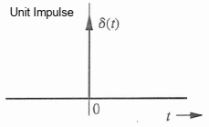
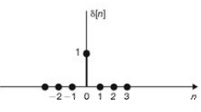
Basic Continuous-Time and Discrete-Time Signals
B. The Unit Impulse Function
The unit impulse function δ(t), also known as the Dirac delta function, is defined as
The unit impulse (or unit sample) sequence δ[n] is defined as

Slide 28
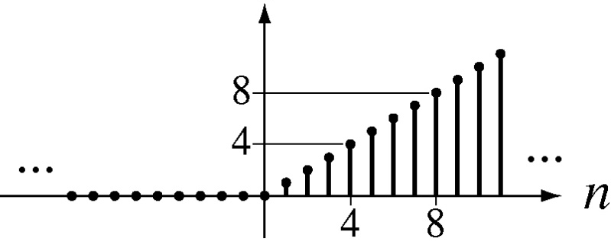
Basic Continuous-Time and Discrete-Time Signals
C. The Unit Ramp Function
The unit ramp function r(t), is defined as
The unit ramp sequence r[n], is defined as
r(t)
1
t
0
1
r[n]

Slide 29
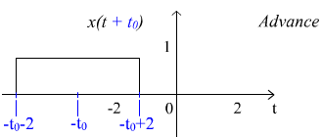
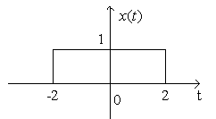
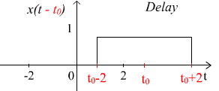
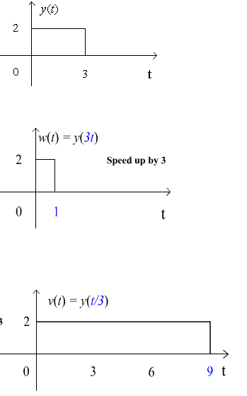
Signal Transformation and Properties
Time Shifting
The original signal x(t) is shifted by an amount tₒ that is x(t ± tₒ).
Time Scaling
The original signal x(t) is scaled by an amount a that is x(at).
a>1 Period reduces and graph shrink or compress
a<1 Period increases and graph Expands

Slide 30
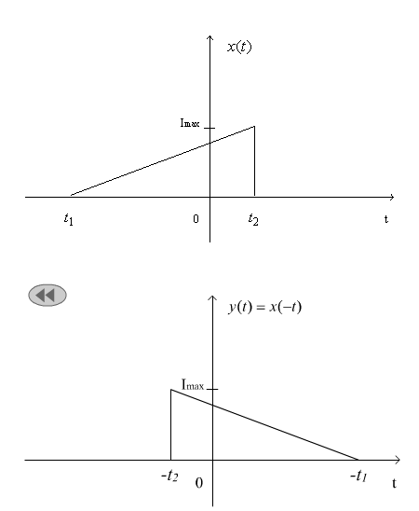
Signal Transformation and Properties
Time Reversal
The original signal x(t) is reversed in time that is x(-t).

Slide 31
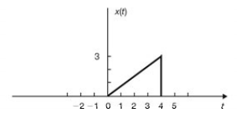
Signal Transformation
Ex. A continuous-time signal x(t) is shown below. Sketch and label each of the following signals.
(a) x(t- 2); Time Shifting
(b) x(2t); Time Scaling
(c) x(t/2); Time Scaling
(d) x(-t) Time Reversal

Slide 32
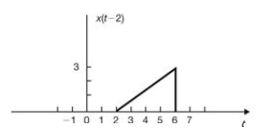
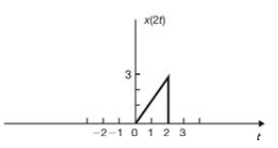
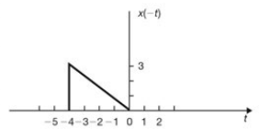
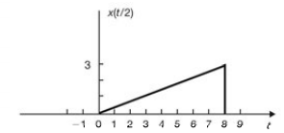
Sol:
(a) x(t- 2); Time Shifting
(b) x(2t); Time Scaling (time compression)
(c) x(t/2); Time Scaling (time expansion)
(d) x(-t) Time Reversal

Slide 33
Reference
Signals-and-systems-2nd-edition-schaums-outline-series-hwei-hsu

